Slide 1
TELE-CONSULTATION PROJECT
DIVINE AI
PRESENTED BY-
Y TUSHAR DEO

Slide 2
ABOUT THE PROJECT
The teleconsutation project is all about the developement of various working Machine Learning models that can be useful in predicting the various factors leading to a disease and its tendanceis in the medical department .
Our primary goals are -
To develope ML models that can predict the disease and factors related to it, depending upon the symptoms .
To help the doctors to diagonose the patients with ease.
To give patients the idea about the disease they are affected with and helping them with the right treatment.
To provide a correct idea about the finances required to deal with the diseases.

Slide 3
PROBLEM STATEMENT
INSURANCE PRICE PREDICTION
To predict the Insurance price that a particular patient have to pay to avail the benefits of a medical insurance .
The Insurance price prediction depends on the various factors of the daily habbits of the patient.

Slide 4
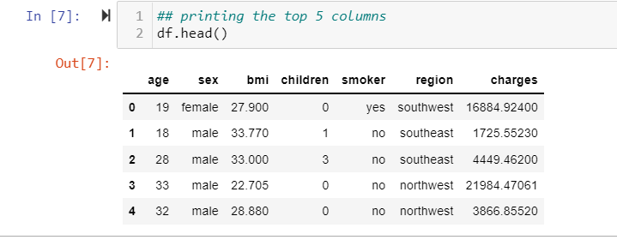
Data collection
The data for the problem statement have been collected from the Kaggle datasets.
The data includes the the various factors such as AGE ,SEX, BMI ,SMOKER etc to predict the insurance charges the patient have to deal with .

Slide 5
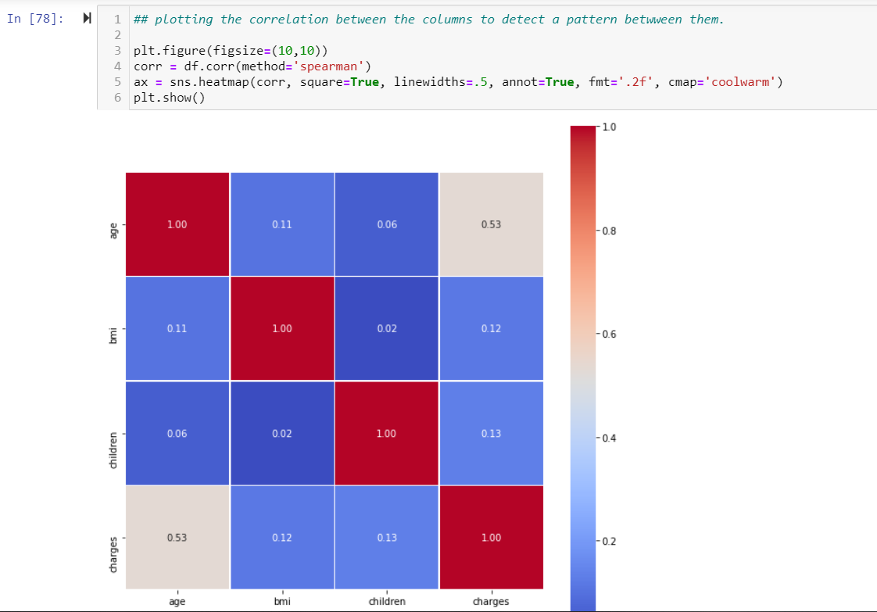
CODE EXPLANATION
1.MODELING OF DATA
The data contains the various factors .Thus to get an idea about the interrelation of the factors with each other first the data correlation has to been done .

Slide 6
From the correlation plot it can easily observed that the factors “CHARGES” and the “AGE” do have the highest correlation with each other
Hence all the other factors would be juged depending upon these factors.

Slide 7
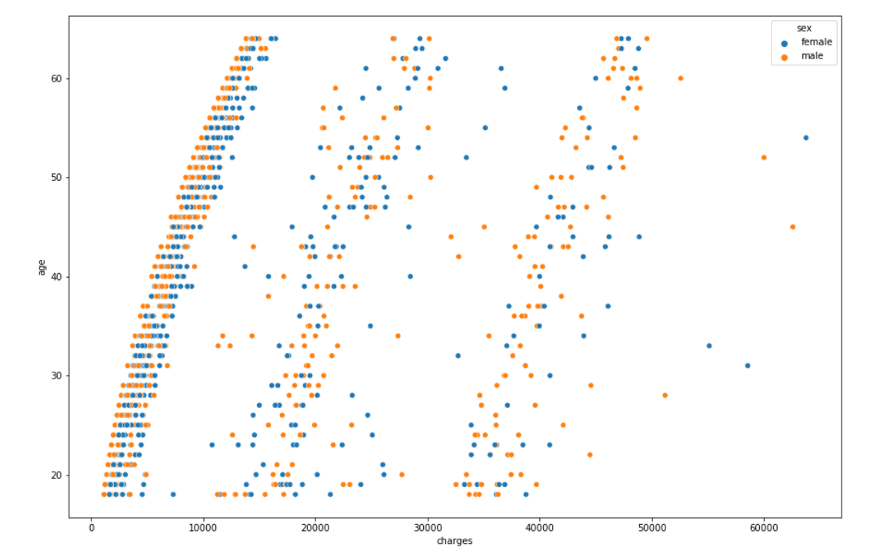
Correlation with SEX
now lets check if "sex" has any relation with the "age" and the "price charged"
so from the plot it can be observed that there is a basic trend that the price charged increases with the increase in the age
but the plot is divided into three groups (0-15k),(15k-30k),(35k-45k).
Hence the age affects the price heavily.

Slide 8
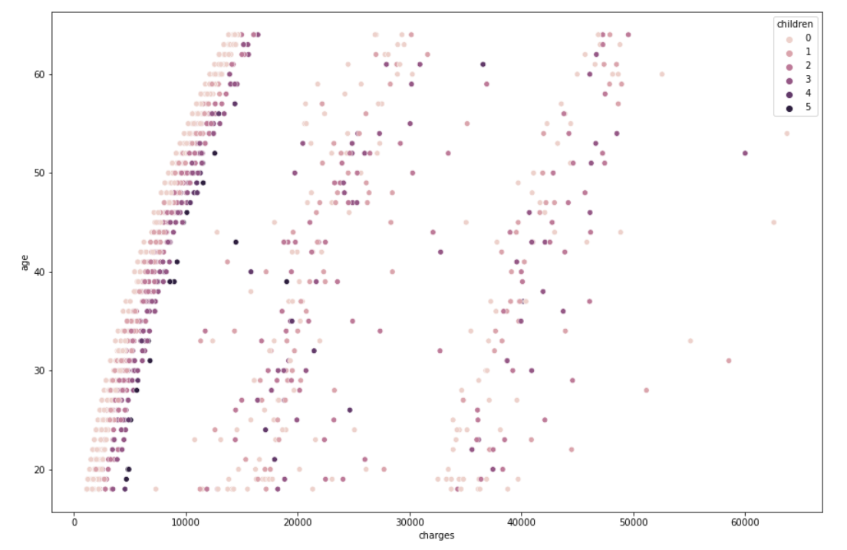
Correlation with BMI
now lets check if "sex" has any relation with the "age" and the "price charged"
it seems that the bmi only affects the price charge on the higher price area. this means that the people with higher bmi supposed to have higher insurace charges.
but still it does not seem to affect much .

Slide 9
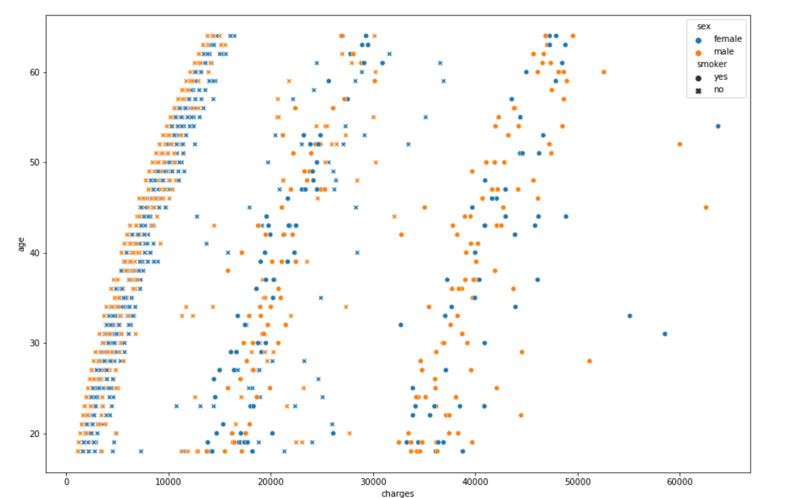
Correlation with SMOKER
Now lets check the correlation with smoker
hence from the plot it is evident that the 1st group is basically the group of smokers . the next two groups have relatively less smokers and the final group has no smokers at all.
hence the smoking seems to have a very strong relation with the insurance charge.

Slide 10
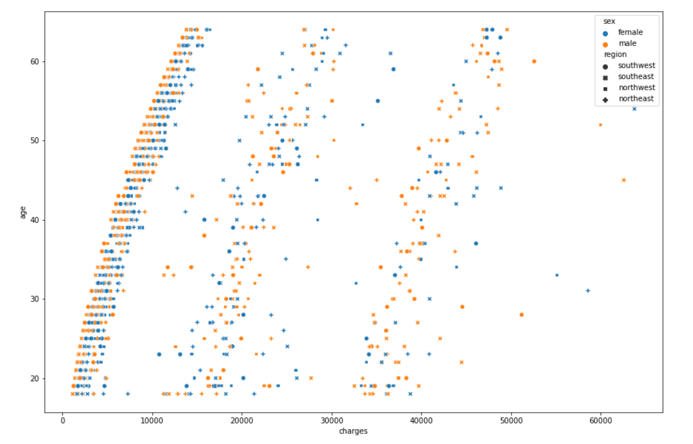
Correlation with REGION
Now lets check the correlation with smoker
nothing can be concluded from this plot . hence the region has nothing to do with the insurance price charge.
Hence the REGION can be deroped from the dataset.

Slide 11
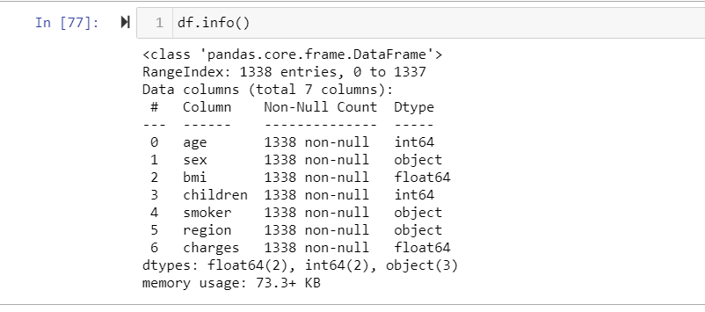
2. DATA PREPARATION
Now after having a detailed analysis about the data ,we can filter the data fro the training and testing it with different models
checking the info to get the numerical and the object type data colums
here we can see that we have 4 numerical colums and 3 object type colums.

Slide 12
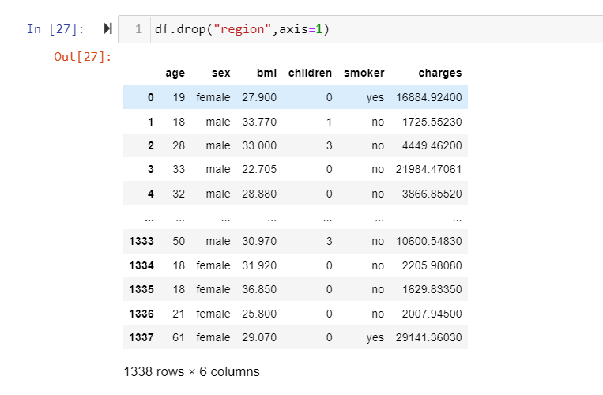
Now as the region column was not having any effect on the prediction hence we can drop that column.

Slide 13
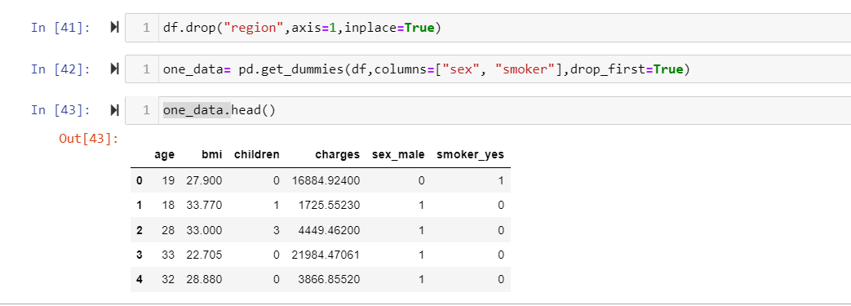
we have to now convert the object colums to the numerical coulums.
we do that with ONE HOT ENCODING

Slide 14
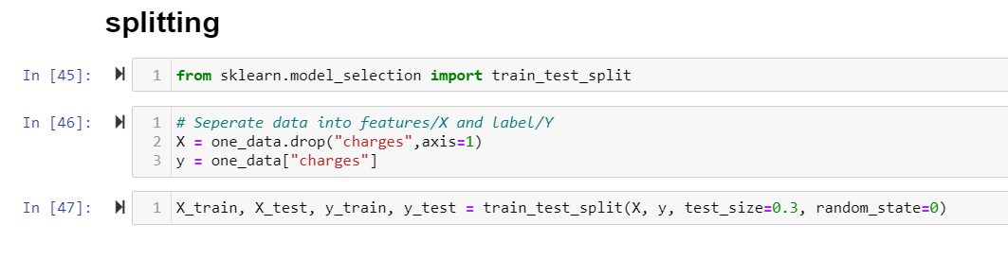
DATA SPLITTING
Now the data cleaned can be splitted with train test split for the model creation

Slide 15
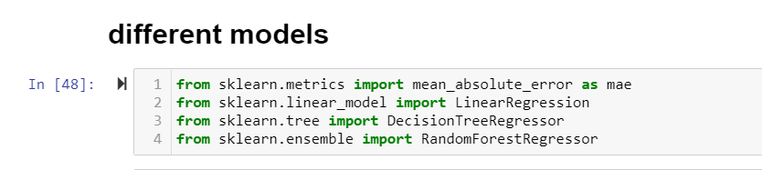
3. MODEL EVALUATION
Now after the splitting of the data into training and testing part we can apply the different models on the data to get the predictions wth the highest acuracy.
Here 3 regressor models are applied to the dataset

Slide 16
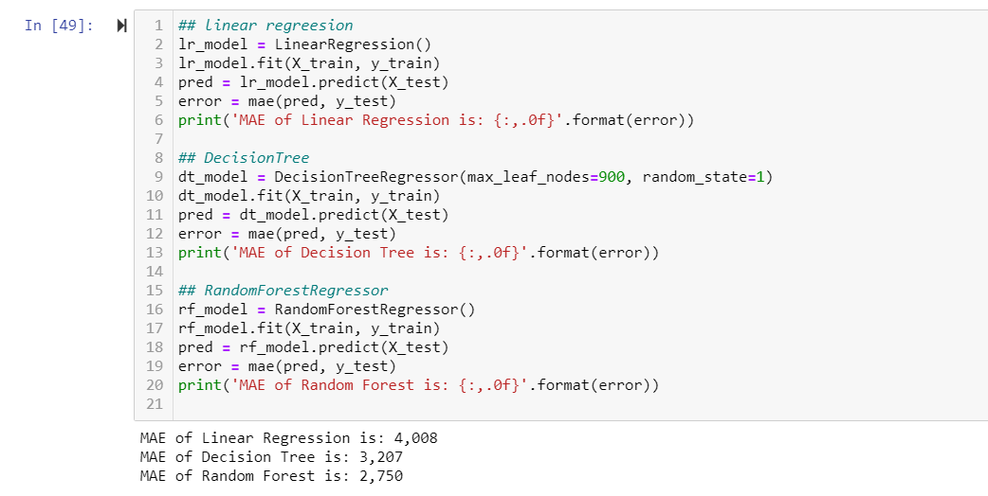
Hence the three models
Linear regression
DecisionTree
RandomForestRegressor
has been used
The mean absolute error is used to calculate the error in the model predictions.

Slide 17
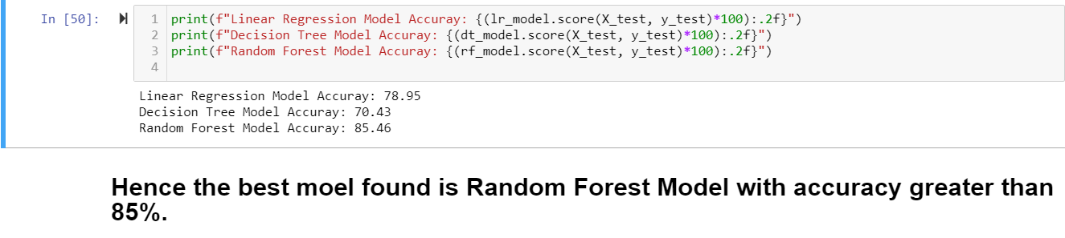
ACCURACY
From the mean absolute error the Model accuracy has been calculated .
Hence models gave the following accuracy.
Linear Regression Model Accuray: 78.95
Decision Tree Model Accuray: 70.43
Random Forest Model Accuray: 85.46

Slide 18
SUMMARY
The data has been modelled to evaluate the factor dependency over each other.
The AGE and the PRICE column has the highest correlation.
The smoker column has the highest effect over the insurance price.
The data has been cleaned and preprocessed.
The 3 models have successfully been implemented over the dataset.
The Random forest regressor gave the highest accuracy of 85 %.
This prediction ML model can now be used to predict the Insurance Price of the patients if the new data of the patients is provided to the Model.
Hence Machine learning have been successfully used to achive the Goal of the project
TELE-CONSULTATION.

